Slide 1
Head Lice 101
An Overview for Parents, Teachers and Communities

Slide 2
Head Lice Fast Facts
Head lice are a common community issue
In the United States, an estimated 6 to 12 million lice infestations occur each year among children aged 3 to 11¹
Children can get head lice anytime they are in close contact with others – for example, during play at home or school, slumber parties, sports activities or camp
Head lice are wingless insects
They live close to the scalp and feed on human blood
They are not dangerous and do not transmit disease, but are easily spread¹
School nurses are often the first to detect head lice
If head lice is suspected, it is important for families to talk to their healthcare provider

Slide 3
Who and How?
Who gets head lice?
Almost anyone can get head lice
Head lice are not a health hazard or sign of poor hygiene²
Children attending preschool or elementary school, and those who live with them, are the most commonly affected.¹
How do head lice spread?
Most often spread by direct head-to-head contact¹
Head lice cannot jump or fly¹
They cannot live off the head for long, so it is uncommon to spread head lice by contact with clothing or other personal items¹
Dogs, cats and other pets do not play a role in spreading head lice¹

Slide 4
Is It Head Lice?
Some people don’t experience symptoms, but those who do most commonly experience:¹
Tickling feeling on the scalp or in the hair
Itching (caused by the bites of the louse)
Irritability and difficulty sleeping (lice are more active in the dark)
Sores on the head (caused by scratching)
Finding a live louse is the best indication of an infestation³

Slide 5
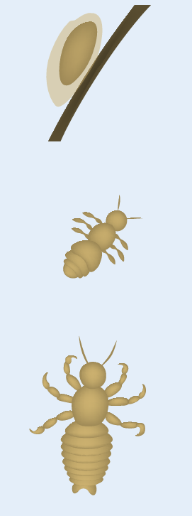
What Do Head Lice Look Like?
When checking a student for head lice, you may see several forms:¹
Nits (eggs)
Teardrop shaped
Attached to the hair shaft
Yellowish or white
Can be confused with dandruff, but cannot be brushed off
Nymph (baby louse)
Grows to adult size in one to two weeks
Found on the scalp or in the hair
Adult louse
Size of a sesame seed
Tan to grayish-white
Commonly behind the ears and near the neckline
Nit
Nymph
Louse

Slide 6
How is Head Lice Treated?
If head lice are suspected, families should consult with a healthcare provider as soon as possible
Key treatment considerations include:
Resistance to some over-the-counter (OTC) head lice treatments has been reported, but the prevalence is not known²
There is no scientific evidence that home remedies are effective⁴
There are prescription treatment options available, contact your healthcare professional to determine what is appropriate for you
All household members and other close contacts should be checked
Anyone with evidence of an active lice infestation should be treated
All persons with active head lice should be treated at the same time⁵

Slide 7
What About Cleaning?
Adult head lice survive less than 1-2 days, and nits (head lice eggs) generally die within a week once they fall off a person and cannot feed¹
Vacuum floor and furniture where the infested person sat or lay⁶
Fumigants or fogs are not necessary and may be dangerous if inhaled or absorbed through the skin⁶
Family bed linens and recently used clothes, hats and towels, as well as personal articles such as combs, brushes and hair clips, should be washed in very hot water or sealed in a plastic bag for two weeks ⁵

Slide 8
Supporting Families Facing Head Lice
Children and parents managing head lice may feel stigmatized and ostracized^{7,8}
We can all help support families facing head lice by:
Dispelling myths
Maintaining privacy
Encouraging families to talk to their healthcare provider
If you want to learn more, contact your school nurse for more Headfirst! Lice Lessons resources or visit NASN.org!

Slide 9
Headfirst! Lice Lessons educational initiative is made possible through a collaboration between the
National Association of School Nurses (NASN)
and Sanofi Pasteur

Slide 10
References
Centers for Disease Control and Prevention (CDC). Parasites: Lice: Head Lice: Frequently Asked Questions. http://www.cdc.gov/parasites/lice/head/gen_info/faqs.html. Accessed October 12, 2012.
Frankowski BL, Bocchini JA, Jr, Council on School Health and Committee on Infectious Diseases, American Academy of Pediatrics. Clinical report – head lice. Pediatrics. 2010;126(2):392-403.
Centers for Disease Control and Prevention (CDC). Parasites: Lice: Head Lice: Diagnosis. http://www.cdc.gov/parasites/lice/head/diagnosis.html. Accessed January 27, 2012.
Centers for Disease Control and Prevention (CDC). Parasites: Lice: Head lice: Treatment Frequently Asked Questions. http://www.cdc.gov/parasites/lice/head/gen_info/faqs_treat.html. Accessed October 18, 2012.
Centers for Disease Control and Prevention (CDC). Parasites: Lice: Head lice: Treatment. http://www.cdc.gov/parasites/lice/head/treatment.html. Accessed October 12, 2012.
Centers for Disease Control and Prevention (CDC). Parasites: Head Lice: Prevention & Control. http://www.cdc.gov/parasites/lice/head/prevent.html. Accessed January 24, 2013.
Parison J, Canyon DV. Head lice and the impact of knowledge, attitudes and practices – a social science overview. In: Management and Control of Head Lice Infestations. UNI-MED, Bremen,Germany, 2010:103-109.
Gordon SC. Shared vulnerability: a theory of caring for children with persistent head lice. J Sch Nurs. 2007;23(5):283-292.
COM 11233

